Slide 1
Retail Sales Performance Dashboard
Built in Tableau using Retail Sales Dataset
Presented by
Shaik Kashifa Misba

Slide 2
Project Overview
Description: This Tableau dashboard was created to analyze and visualize key metrics from a retail sales dataset
Tools used: Tableau
Dataset: Retail sales data with fields like date, category, price, quantity, total, etc.
Goals:
Track KPIs: Sales, Profit, Growth
Identify sales trends over time
Understand customer demographics
Enable interactive filtering

Slide 3
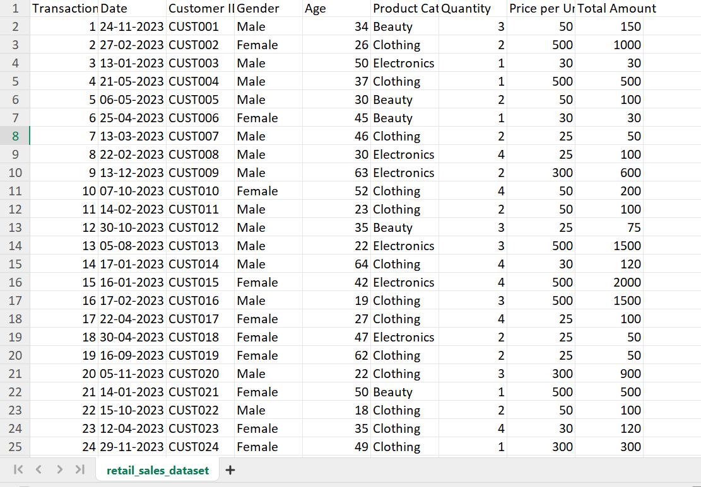
Dataset Overview
Source: Retail Sales Dataset (Kaggle)
Fields Used:
Date, Customer ID, Gender, Product Category
Transaction ID, Age, Price per Unit, Quantity, Total Amount

Slide 4
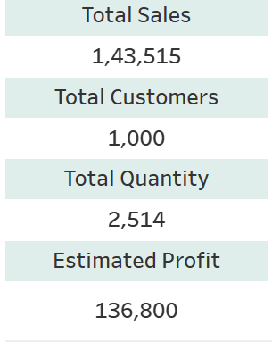
Key Performance Indicators(KPI’s)
Highlights:
Total Sales
Estimated Profit
Sales Growth %

Slide 5
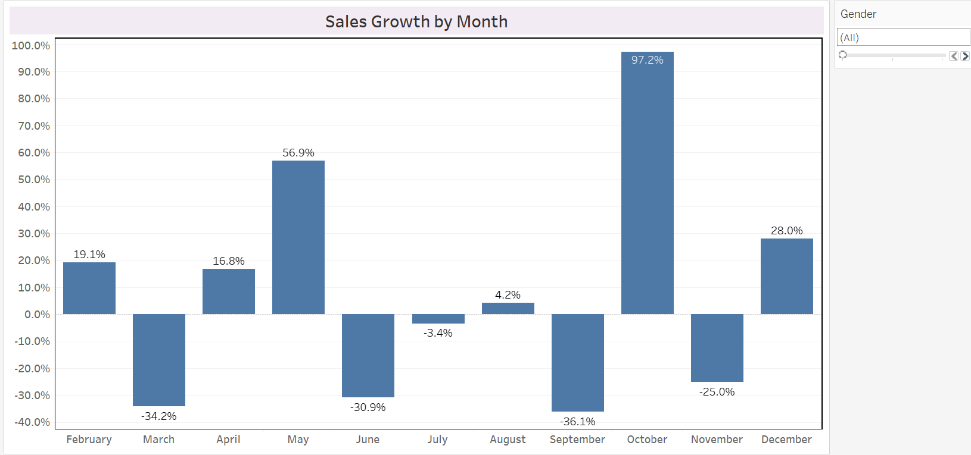
Sales Growth % – KPI Insight
This KPI shows the percentage change in sales month-over-month, helping track business performance over time.
Positive growth indicates successful sales strategies or seasonal demand.
Negative growth may signal areas needing attention such as marketing gaps or product issues.

Slide 6
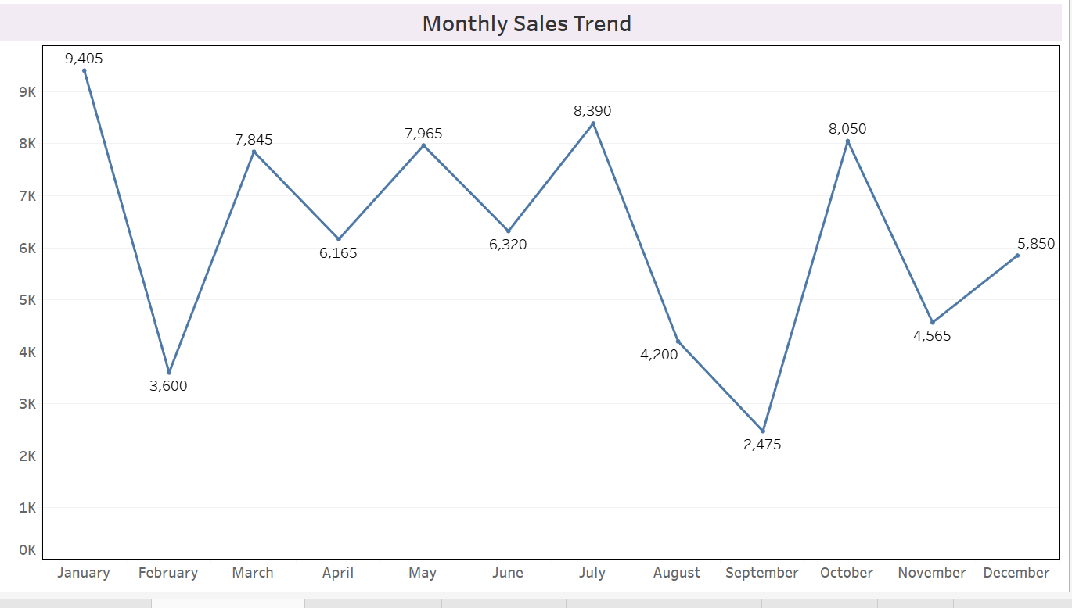
Time –Series Analysis
This line chart represents the monthly sales performance over time. From the trend, we can observe seasonal fluctuations in customer spending.
Peak sales were recorded during [mention peak month, e.g., January], likely due to year-start promotions or festive shopping.

Slide 7
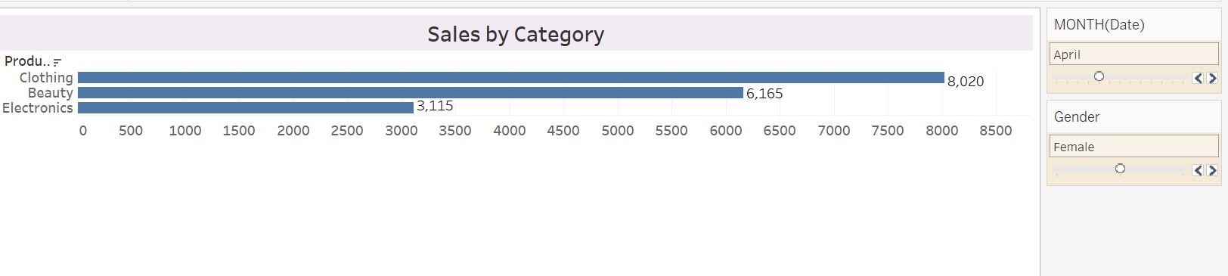
Product-Wise Performance
This bar chart shows how different product categories contribute to total sales.
The top-performing categories include [e.g., "Clothing"],indicating higher demand or profit margins in these segments.
Using the category slicer, users can dynamically filter the data to analyze individual category performance and compare trends over time.

Slide 8
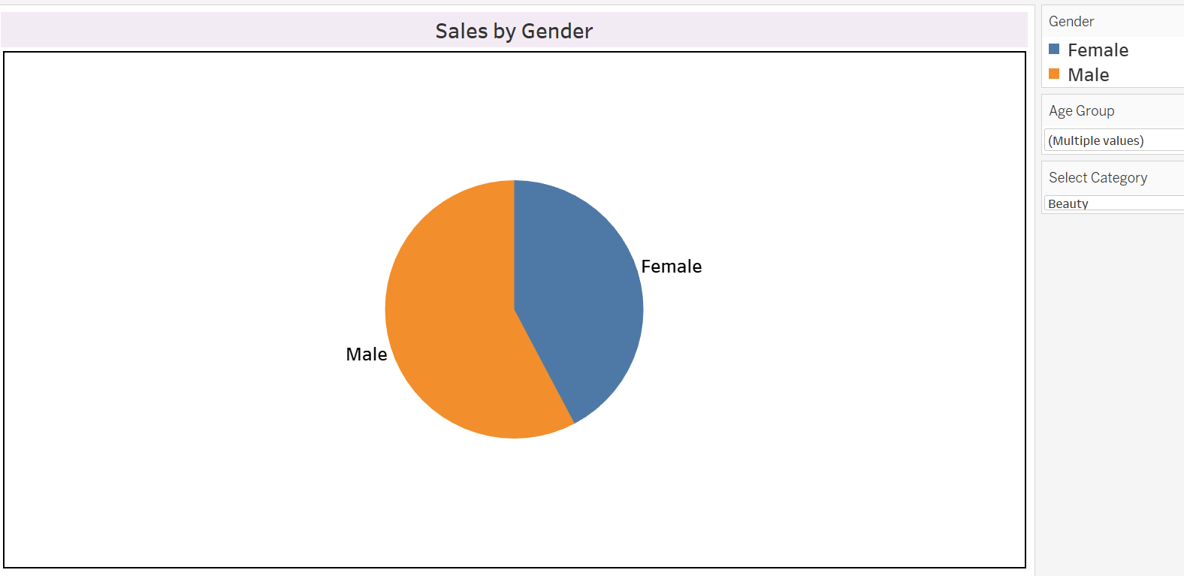
Customer Demographics
This chart displays sales distribution based on customer gender.
From the visualization, we can observe that [e.g., Female customers] contribute more to overall sales compared to [Male customers].
This insight helps businesses in targeting marketing campaigns more effectively and tailoring product offerings based on the dominant customer group.

Slide 9
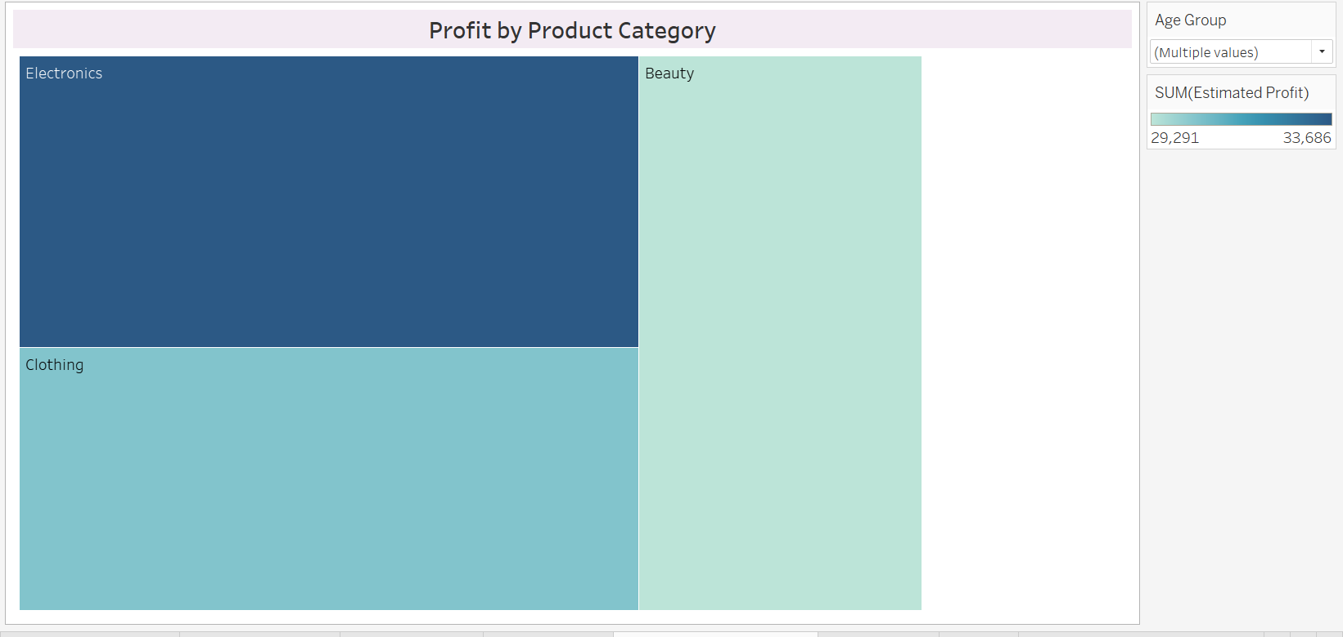
Profit Analysis
This visualization highlights how profit varies across different product categories and customer genders.
Some categories may show high sales but lower profit margins, while others contribute significantly to overall profit.
It also reveals which customer segments (e.g., Male/Female) are more profitable.

Slide 10
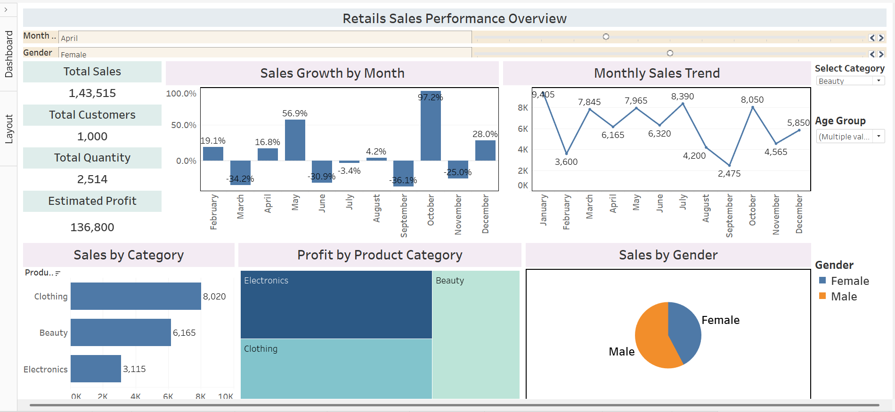
Final Dashboard View
This dashboard provides a comprehensive, interactive view of sales performance using KPIs, trend analysis, and demographic insights.
Users can interact through slicers (e.g., Product Category) and filters (e.g., Gender, Date) to explore data dynamically.
Key insights, such as Sales Growth %, Top Categories, and Profit Trends, are presented clearly using cards and charts.
It’s designed for quick decision-making and a better understanding of retail sales behavior.

Slide 11
Conclusion
Through this dashboard project, I learned how to transform raw retail data into meaningful visual insights using Tableau.
I analyzed sales trends, customer demographics, product performance, and profitability, gaining a clearer view of the business landscape.
Key insights like peak sales months, high-performing categories, and gender-based customer contributions help drive better decisions.
This project highlights how interactive dashboards empower businesses to make data-driven strategies, spot trends quickly, and improve overall efficiency in decision-making.

Slide 12
Thank You !!
Shaik Kashifa Misba
shaikkashifamisba@gmail.com

